Slide 1
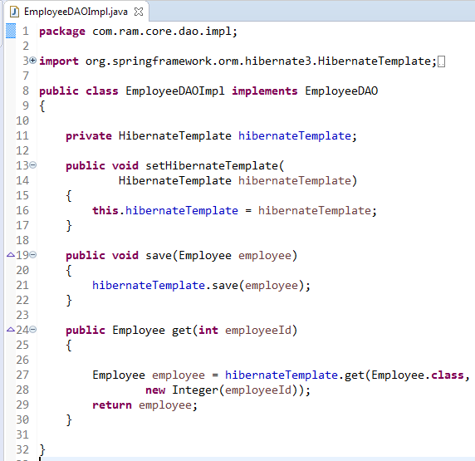
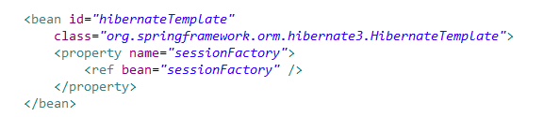
HibernateTemplate in Spring
HibernateTemplate is the class of org.springframework.orm.hibernate3.
HibernateTemplate provides the integration of hibernate and spring.
Spring manages database connection DML, DDL etc commands by itself.
HibernateTemplate has the methods like save, bulkUpdate, delete, evict etc
hibernateTemplate will be used in the DAO classes. Initialize hibernateTemplate. Provide a setter method to set hibernateTemplate by spring.

